Slide 1
Deep Learning
Dr Milan Joshi

Slide 2
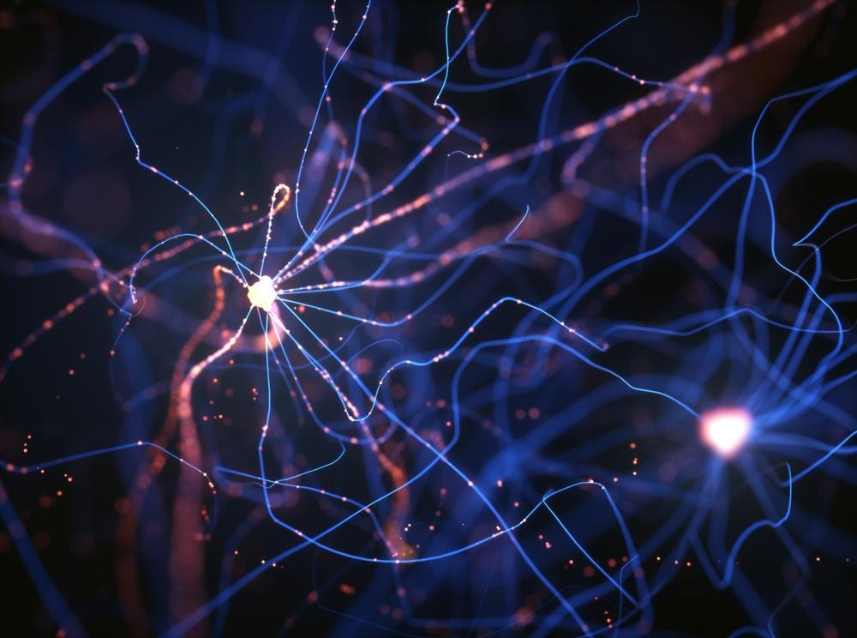
Fundamentals of Deep Learning

Slide 3
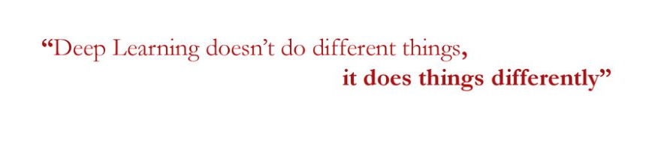
What is Deep Learning?

Slide 4
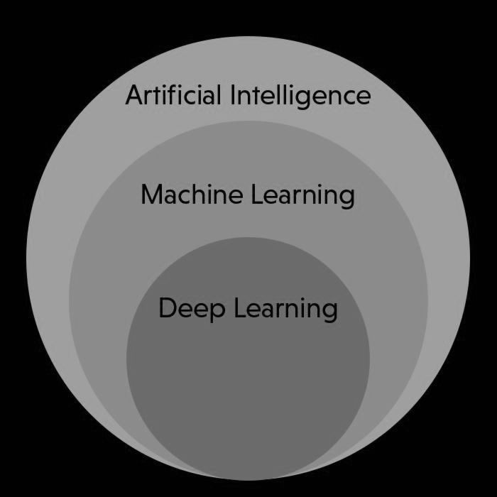
Deep Learning is a type of Machine Learning
Notes:
Alright, everyone, let's take a closer look at this slide. This diagram is an excellent way to understand the hierarchy and relationship between three key concepts in the field of AI: Artificial Intelligence (AI), Machine Learning (ML), and Deep Learning (DL).
1. Artificial Intelligence (AI)
AI is the biggest circle here, representing the broadest category. Think of AI as the umbrella term that covers everything we do to make machines "smart." AI includes any technique or approach that allows a computer or machine to mimic human behavior or intelligence. This can be anything from rule-based systems (like if-then statements) to more sophisticated systems like the ones that play chess or recommend movies.
2. Machine Learning (ML)
Now, let's move one level deeper into Machine Learning. Machine Learning is a subset of AI, which means it's a specific approach within the larger field of AI. Machine Learning is all about teaching machines to learn from data. Instead of programming a machine with explicit rules, we give it examples (data) and let it find patterns, learn from them, and make decisions or predictions based on this learning.
For example, when you use a spam filter in your email, that’s machine learning at work. It looks at thousands of examples of spam and non-spam emails, learns the patterns, and then uses those patterns to predict whether new emails are spam.
3. Deep Learning (DL)
Finally, we get to the innermost circle: Deep Learning. Deep Learning is a more specialized subset of Machine Learning. It uses structures called neural networks, which are inspired by the human brain. These networks have many layers (which is why it’s called “deep” learning) and can learn very complex patterns from large amounts of data.
Deep Learning shines in situations where we have a lot of data and we need to identify very complex patterns. Think about recognizing faces in photos, understanding spoken language, or even driving a car. These tasks require understanding a lot of subtle details, and deep learning has proven to be incredibly effective in these areas.
Why This Matters:
The diagram visually shows us that Deep Learning is a type of Machine Learning, and Machine Learning is a type of AI. As we move inward from AI to Machine Learning to Deep Learning, we get more specialized. AI is the big picture—our goal of making machines smart. Machine Learning is one approach to achieve that goal by letting machines learn from data. Deep Learning is a specialized technique within Machine Learning that excels in working with large and complex datasets.
To Remember:
Not all AI uses Machine Learning, but all Machine Learning is a form of AI.
Not all Machine Learning uses Deep Learning, but all Deep Learning is a type of Machine Learning.
By understanding these layers, we get a clearer picture of where we are going when we talk about AI, Machine Learning, and Deep Learning. We start broad and get more specialized as we dive deeper into the techniques that power today's intelligent systems.
Does this make sense? Do you have any questions about these distinctions or how they fit together?

Slide 5

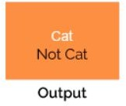
Machine Learning vs. Deep Learning

Slide 6
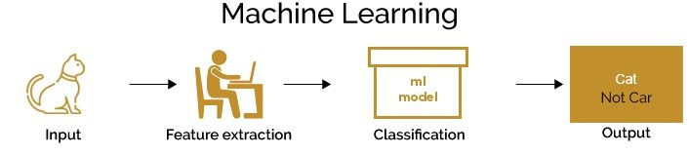

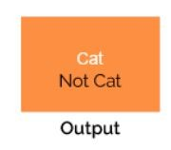
Machine Learning vs. Deep Learning

Slide 7
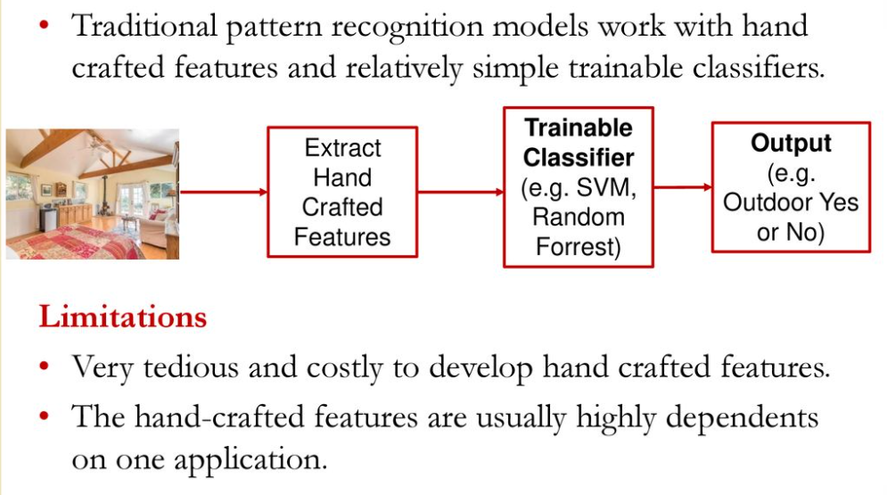
Machine Learning vs. Deep Learning

Slide 8
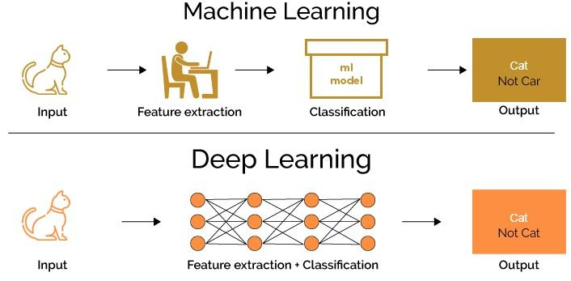
Machine Learning vs. Deep Learning

Slide 9
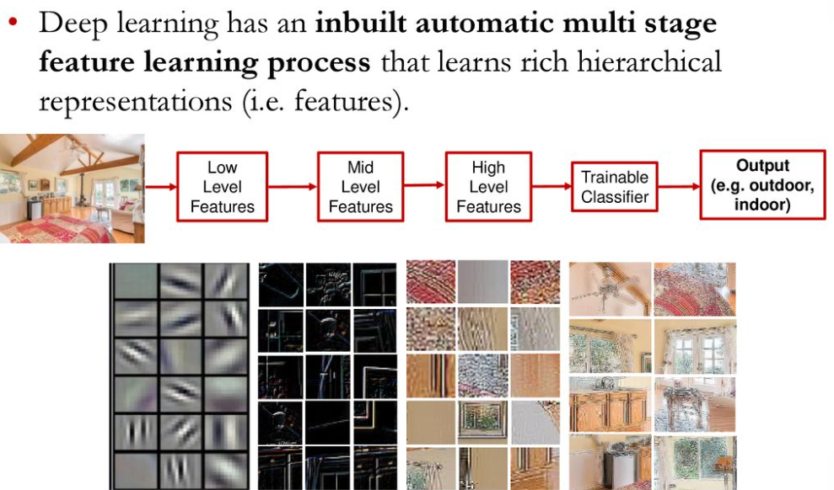
Machine Learning vs. Deep Learning

Slide 10

Represent the world as nested hierarchy of concepts

Slide 11
Represent the world as nested hierarchy of concepts
1. Four Lines
Deep learning models learn representations hierarchically. For example, when learning to recognize a square:
First Level (Primitive Concepts): The model learns very basic elements like individual lines.

Slide 12
Represent the world as nested hierarchy of concepts
Four Lines
They are connected, Closed, perpendicular to each other
Second Level (Simple Relationships): It learns that these lines are connected, form a closed loop, and are perpendicular to each other.

Slide 13
Represent the world as nested hierarchy of concepts
Four Lines
They are connected, Closed, perpendicular to each other
All lines are equal in length
Third Level (Complex Patterns): The model learns that all the lines are equal in length, which collectively forms the concept of a square.

Slide 14

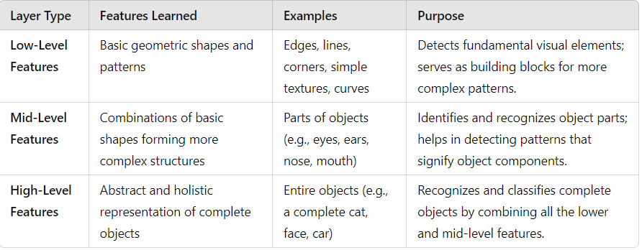

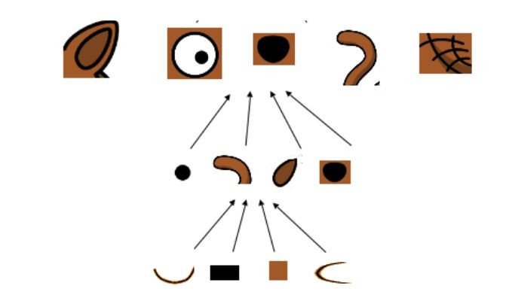
What is Deep Learning?
Identifies what are the edges
Builds on this hierarchically to find combination of shapes and edges

Slide 15



What is Deep Learning?
Identifies what are the edges
Builds on this hierarchically to find combination of shapes and edges

Slide 16


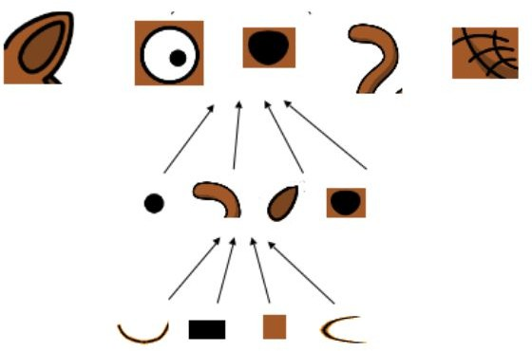
What is Deep Learning?
Identifies what are the edges
Builds on this hierarchically to find combination of shapes and edges
Identifies which of these features are responsible for Cat Vs. Dog classification

Slide 17
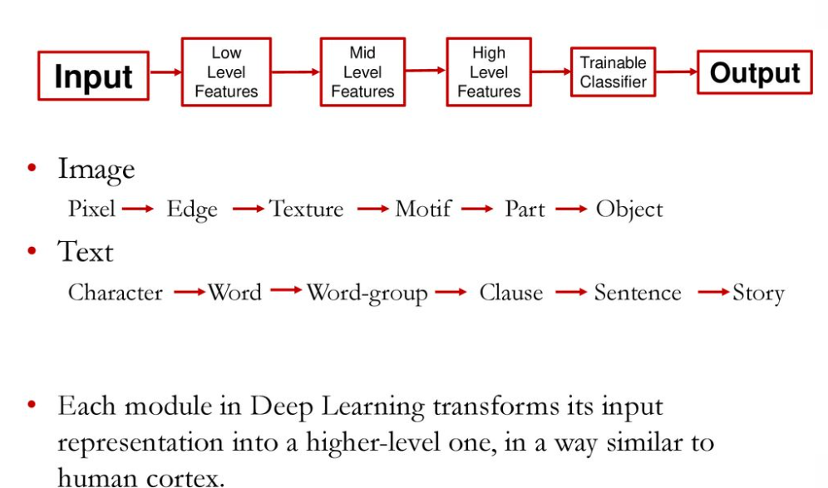

Slide 18
Automatic Feature Extraction

Slide 19
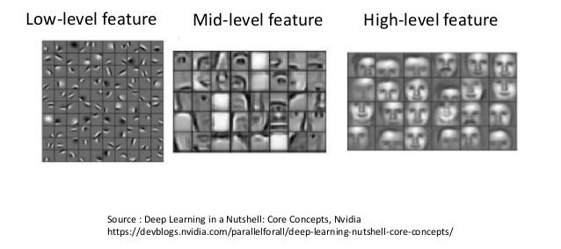
Automatic Feature Extraction

Slide 20
Data Type | Input | Low-Level Features | Mid-Level Features | High-Level Features | Trainable Classifier | Output
Image | Raw Image | Pixels, Edges | Textures, Motifs | Parts, Objects | Image Classifier | Object Recognition
Text | Raw Text | Characters, Words | Word Groups, Clauses | Sentences, Stories | Language Model | Text Generation
Audio | Raw Audio Waveform | Sound Wave Patterns, Amplitude | Phonemes, Timbre, Rhythm | Words, Melody, Genre | Speech Recognition, Genre Classifier | Recognized Speech, Classified Genre
Sensor | Raw Sensor Data | Measurements (Temp, Pressure) | Trends, Anomalies | Behavioral Patterns | Predictive Maintenance | Alerts, Predictions
Financial | Raw Market Data | Price Movements, Volatility | Technical Indicators, Patterns | Market Sentiment, Trend Analysis | Stock Price Predictor | Buy/Sell Recommendations
Medical | Raw Medical Images | Pixels, Edges, Intensities | Tissue Structures, Textures | Organ, Lesion Detection | Disease Detection | Diagnosis, Treatment Recommendations
Social Media | Raw Text, Images, Videos | Words, Hashtags, Pixels | Sentiments, Topics | User Patterns, Influencer Identification | Sentiment Analysis | Advertisements, Content Suggestions
Genomic | Genetic Sequences | Nucleotide Bases (A, T, C, G) | Codons, Gene Sequences | Gene Functions, Variations | Disease Risk Predictor | Personalized Medicine

Slide 21
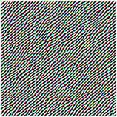
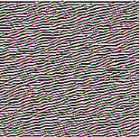
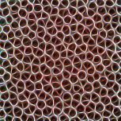
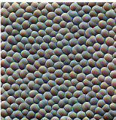
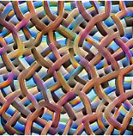
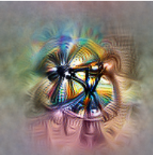
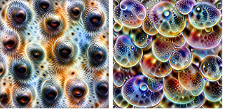
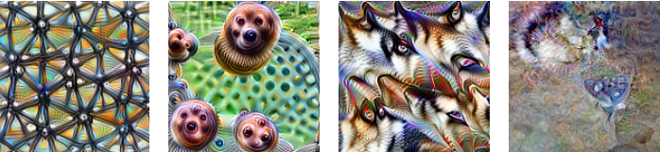
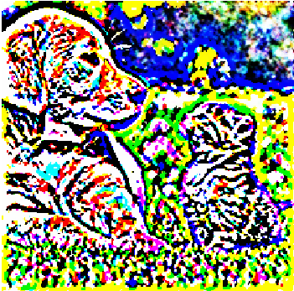

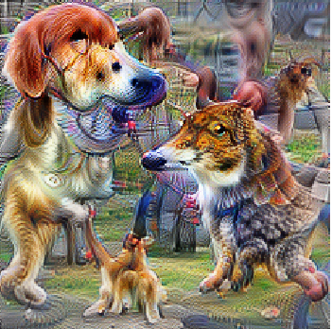
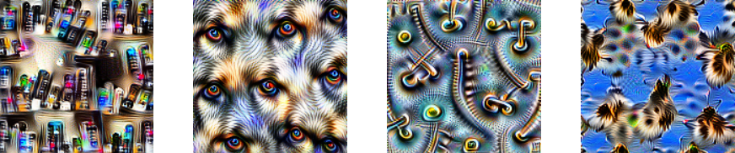

Slide 22
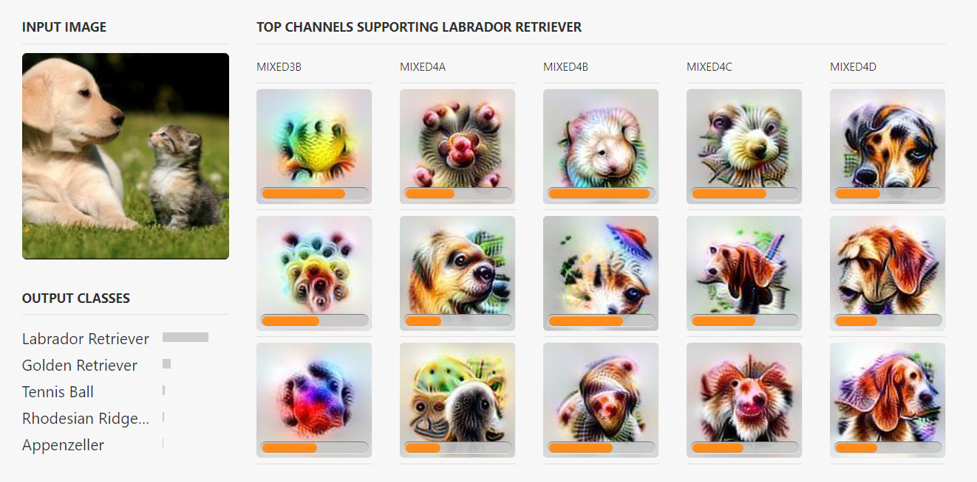

Slide 23
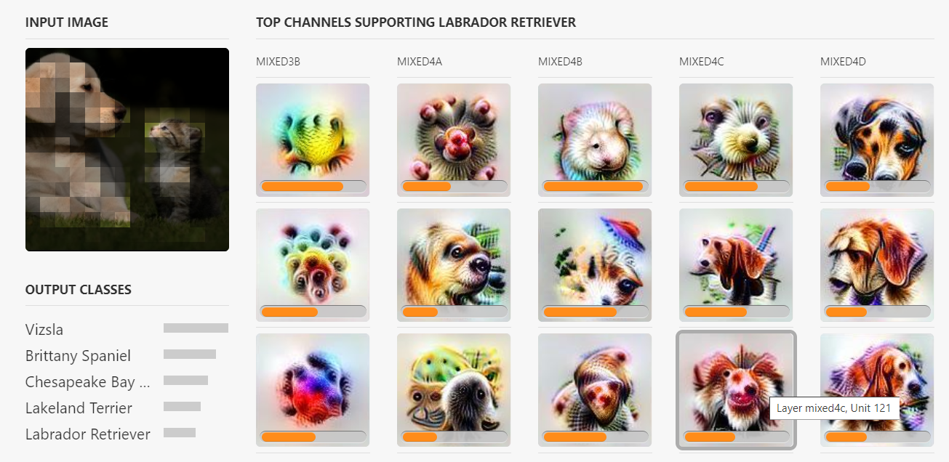
https://distill.pub/2018/building-blocks/

Slide 24
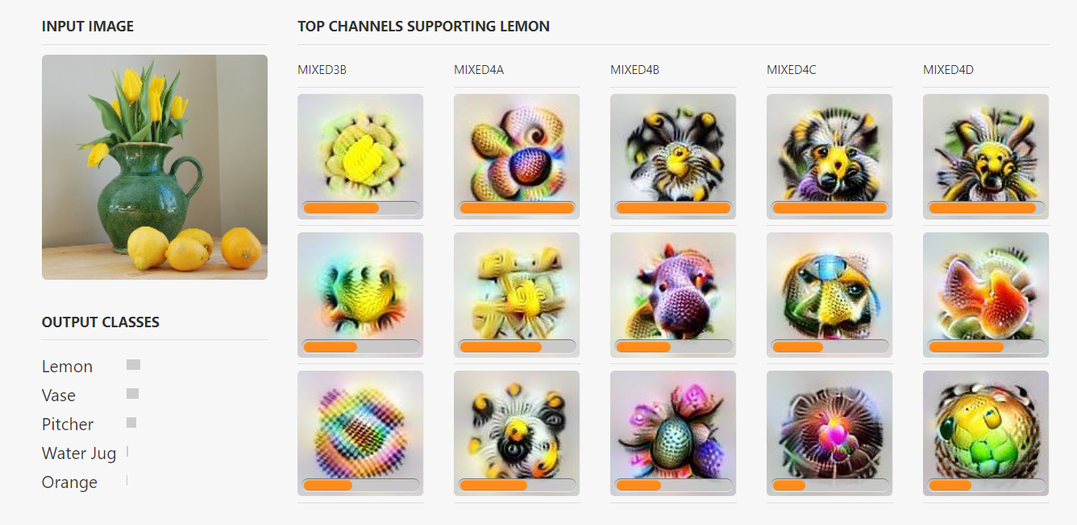

Slide 25
What is Deep Learning?
“Deep learning is a particular kind of machine learning that achieves great
power and flexibility by learning to represent the world as nested hierarchy of
concepts, with each concept defined in relation to simpler concepts, and more
abstract representations computed in terms of less abstract ones”

Slide 26

Performs well with high amount of Data

Slide 27
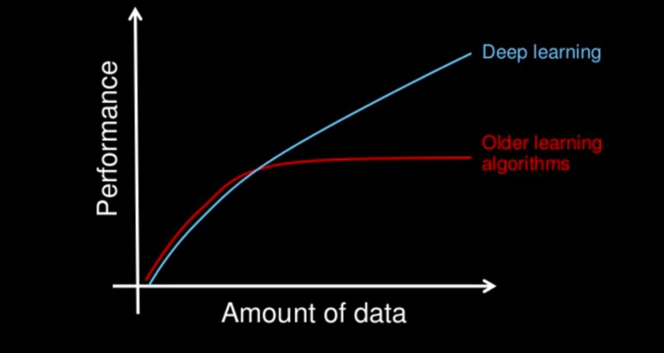
Performs well with high amount of Data

Slide 28
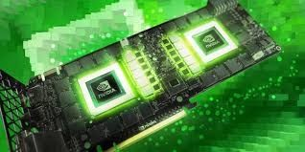
Deep Learning algorithms require more computation power

Slide 29
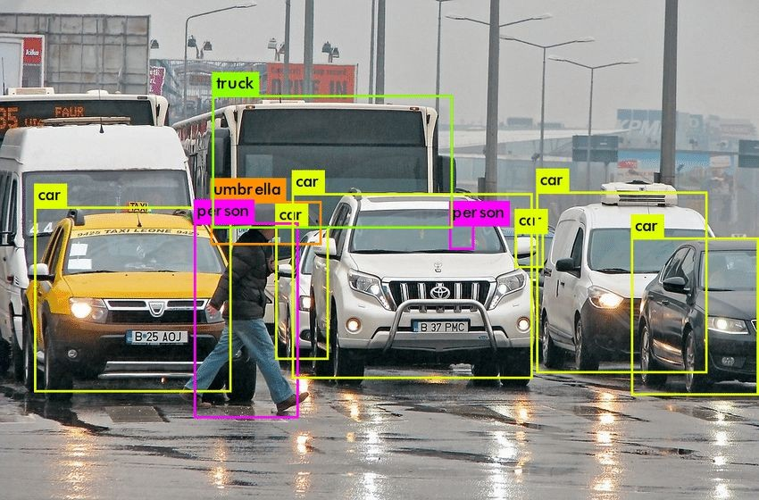
Deep Learning helps to solve problems End -to- End

Slide 30
Deep Learning helps to solve problems End -to- End

Slide 31
Deep Learning helps to solve problems End -to- End
1. Object Detection

Slide 32
Deep Learning helps to solve problems End -to- End
1. Object Detection
2. Object
Recognition

Slide 33
Deep Learning is less interpretable

Slide 34
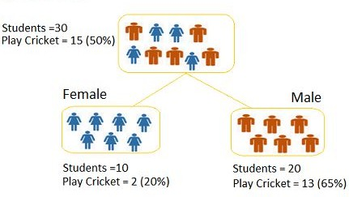
Deep Learning is less interpretable
The tree starts with 30 students, out of which 15 (50%) play cricket.
It then splits the students into two groups: "Female" and "Male.
"For the "Female" group: Out of 10 students, only 2 (20%) play cricket.
For the "Male" group: Out of 20 students, 13 (65%) play cricket.
The decision tree clearly shows the decision-making process, where you can see how each input (e.g., gender) affects the output (e.g., the likelihood of playing cricket).
The logic is explicit and easy to follow.

Slide 35
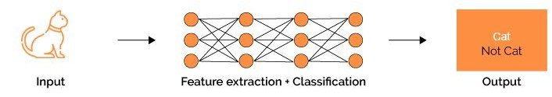
Deep Learning is less interpretable
The decision tree clearly shows the decision-making process, where you can see how each input (e.g., gender) affects the output (e.g., the likelihood of playing cricket). The logic is explicit and easy to follow.
Unlike the decision tree, the deep learning model does not provide clear insight into how it reaches its conclusions. The decision-making process involves many hidden layers and a complex combination of weights and activations, which are not easy for humans to interpret.

Slide 36
Machine Learning Vs. Deep Learning
Automatic Feature Extraction
Performs well on More Data
Requires More Computation Power
Less Interpretable

Slide 37
Why Deep Learning has become so popular among data scientists?

Slide 38
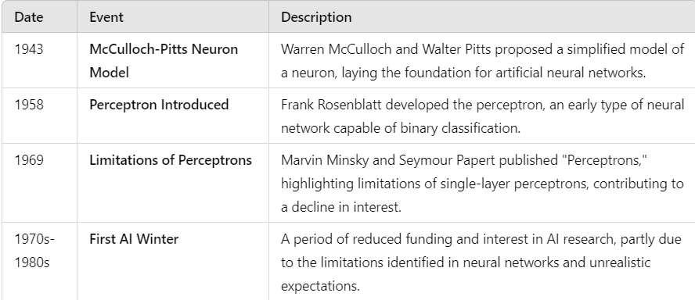
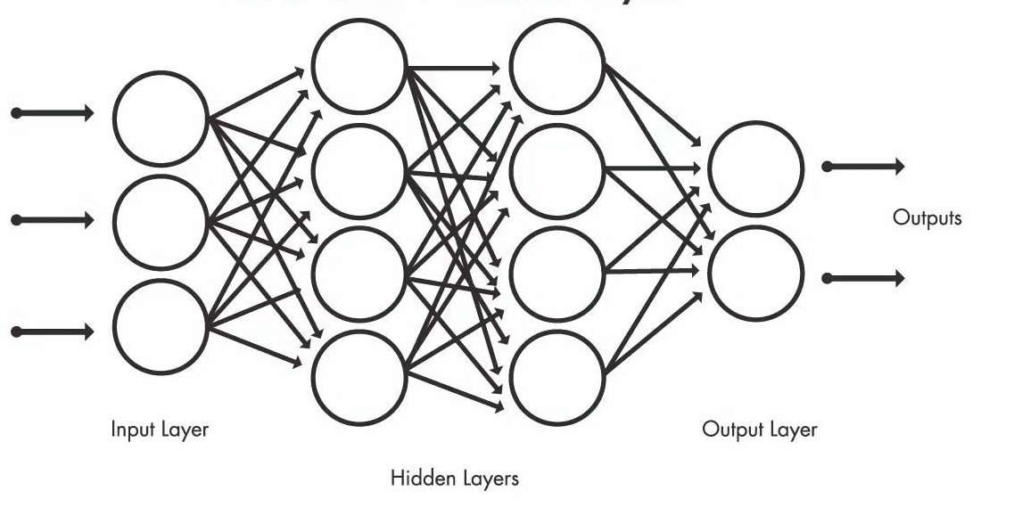
Why has Deep Learning become so popular?

Slide 39
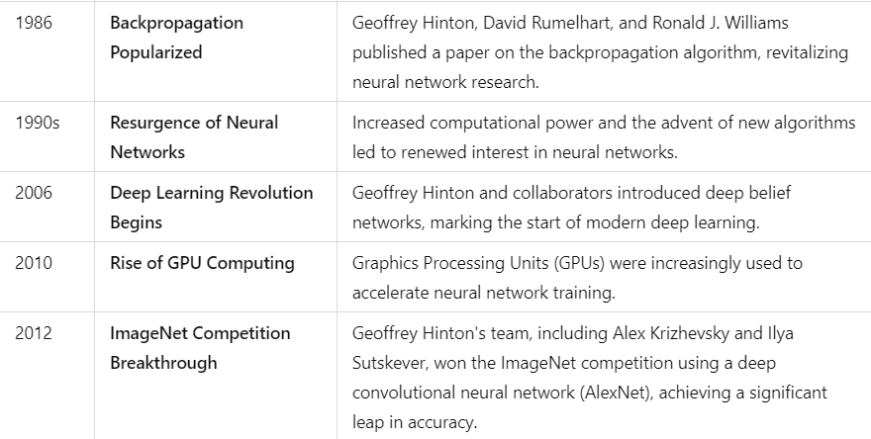
Why has Deep Learning become so popular?

Slide 40

Reasons behind this attention
Data
Popularity of Deep Learning
Reserach
Computational Resources
Applications

Slide 41
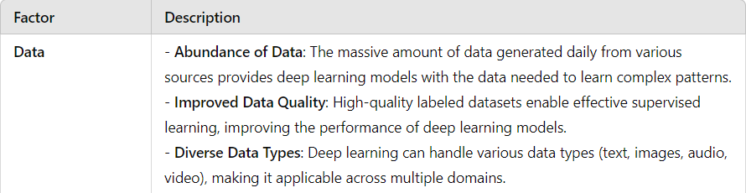
Reasons behind this attention
Data
Popularity of Deep Learning
Reserach
Computational Resources
Applications

Slide 42
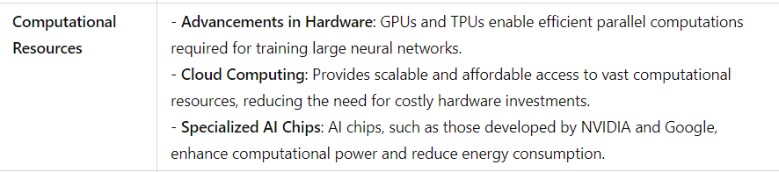
Reasons behind this attention
Data
Computational Resources
Popularity of Deep Learning
Reserach
Computational Resources
Applications

Slide 43
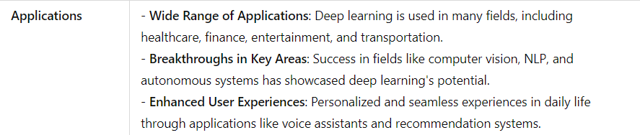
Reasons behind this attention
Applications
Data
Popularity of Deep Learning
Reserach
Computational Resources
Applications

Slide 44
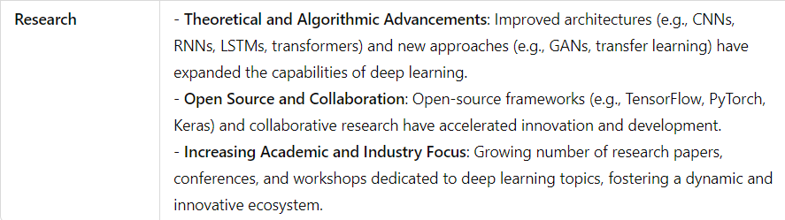
Reasons behind this attention
Research
Data
Popularity of Deep Learning
Reserach
Computational Resources
Applications

Slide 45








Reasons behind this attention
Data
Computational Resources
Research
Applications

Slide 46
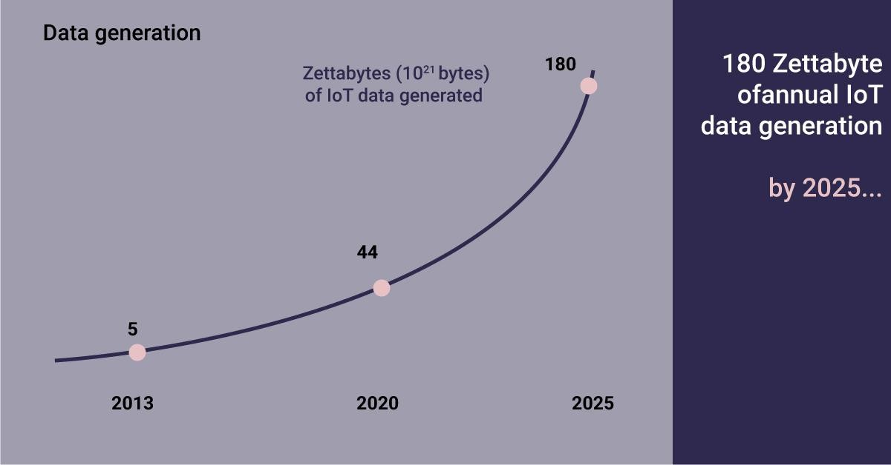








Exponential Data Growth since 2013
Data
_{Research} Computational Resources
Applications
Source: https://fortune.com/2018/09/24/business-strategy-technology-mckinsey/

Slide 47
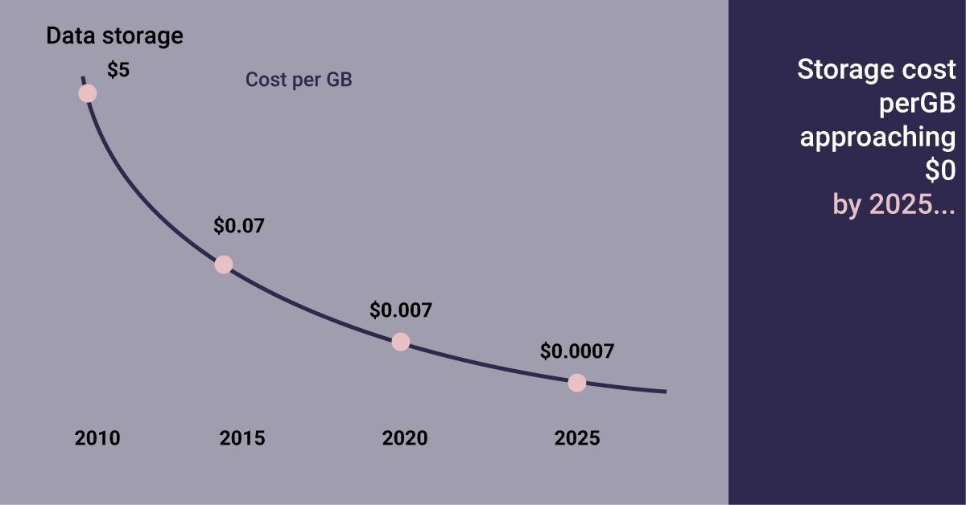
Reduction in Data Storage cost
Data
_{Research} Computational Resources
Applications
Source: https://fortune.com/2018/09/24/business-strategy-technology-mckinsey/

Slide 48
Performs well with high amount of Data

Slide 49
The Computational Power increased by 100,000 times since 2000
Data
Research
Computational Resources
Applications

Slide 50
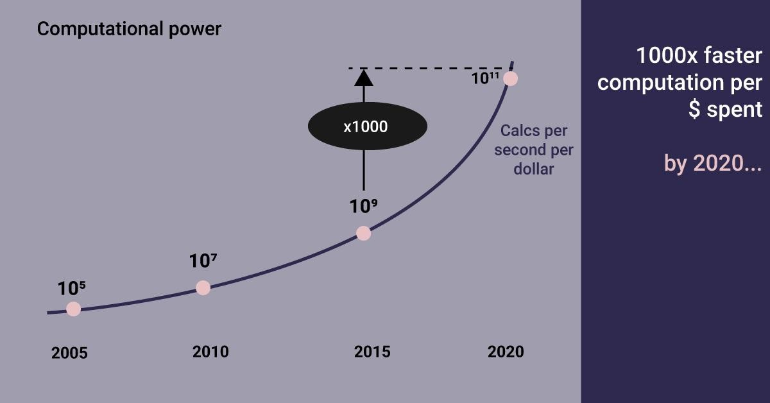
The Computational Power increased by 1000 times since 2015
Data
Research
Computational Resources
Applications
Source: https://fortune.com/2018/09/24/business-strategy-technology-mckinsey/

Slide 51
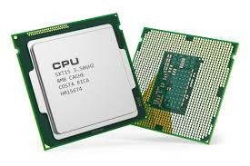
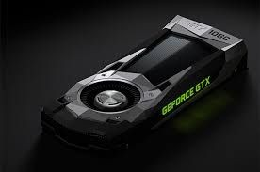
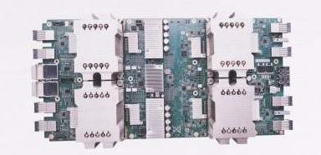
CPU vs GPU vs TPU
GPU
TPU
CPU

Slide 52
Cloud GPU/ TPU Alternatives for Deep Learning
Google Colaboratory (Both GPU and TPU)
Kaggle Kernels
Paperspace
Vast.AI
Oracle Cloud
Amazon Web Services (AWS)
Microsoft Azure
Google Cloud Platform (GCP)

Slide 53




Deep Learning Framework

Slide 54
What kind of Hardware is needed for Deep Learning?
Graphics Processing Unit (GPU)
NVIDIA GTX 1060, GTX 1070, GTX 1080 and above
RAM
8 GB and above
HDD/SSD
1TB HDD (datasets) and good to have 256GB SSD (faster preprocessing)
CPU
i5 8th Gen and above

Slide 55
Availability of Data and Computational Resources leads to more Applications
Data
Computational
^{Research} Resources
Neural Network was there since 1960’s but due to less availability of data and computer resources, we were not able to apply in industry
Applications

Slide 56
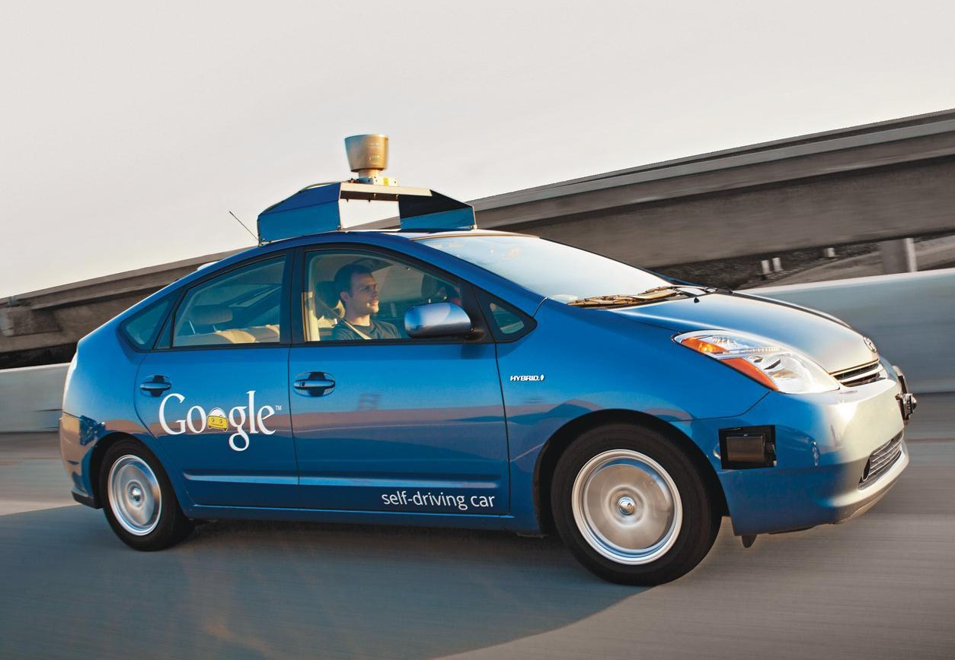
Applications of Deep Learning: Automobile
Deep learning has been instrumental in the development of self-driving cars. These vehicles rely on complex algorithms, advanced sensors, and deep neural networks to perceive their environment, make decisions, and navigate safely without human intervention.

Slide 57
Applications of Deep Learning: Automobile
Real-World Examples and Current Developments
Waymo (Google’s Self-Driving Car Project):
Waymo, initially a Google project, is one of the leading companies in developing self-driving cars. It uses deep learning algorithms extensively for perception, decision-making, and path planning. Waymo's cars have driven millions of miles on public roads and in simulation, continually improving their safety and reliability.
Tesla Autopilot:
Tesla’s Autopilot and Full Self-Driving (FSD) systems rely on neural networks to interpret data from cameras and sensors, navigate, and control the vehicle in various driving conditions. Tesla's approach focuses on vision-based deep learning, using large amounts of data collected from its fleet of cars to train its models.
NVIDIA Drive:
NVIDIA has developed the Drive platform, a complete hardware and software stack for autonomous vehicles. It uses deep learning to handle perception, mapping, and control tasks. The platform is designed to enable Level 4 and Level 5 autonomous driving, where the car can handle all driving tasks without human intervention.
Uber Advanced Technologies Group (ATG):
Uber ATG has worked on developing self-driving technologies that use deep learning for perception and decision-making. Although the project faced challenges, the research has contributed to advancements in autonomous vehicle technology.

Slide 58
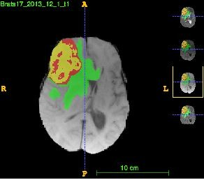
Applications of Deep Learning: Healthcare
The image shows a brain scan where deep learning algorithms have been used to identify and highlight specific regions, such as a tumor or abnormal tissue. The different colors represent distinct areas of interest—such as lesions, edema (swelling), or healthy tissue—detected by the model.

Slide 59
Applications of Deep Learning: Healthcare
Real-World Examples of Deep Learning in Medical Imaging
Google Health's Deep Learning Models: Google Health has developed deep learning models to analyze medical images, including retinal scans to detect diabetic retinopathy and lung scans for cancer detection. These models have shown high accuracy rates, sometimes surpassing human experts.
Enlitic and Zebra Medical Vision: Companies like Enlitic and Zebra Medical Vision use AI and deep learning to detect diseases from X-rays, CT scans, and other types of medical imaging. Their tools help radiologists make more accurate and faster diagnoses.
DeepMind's AI for Eye Disease: DeepMind (a subsidiary of Alphabet) collaborated with Moorfields Eye Hospital in London to develop an AI system capable of detecting over 50 different eye diseases from 3D OCT scans, potentially speeding up diagnosis and treatment.

Slide 60
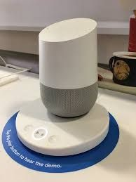
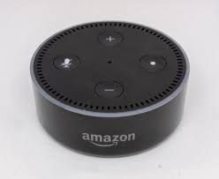
Applications of Deep Learning: AI assistant
AI assistants, such as Google Assistant and Amazon Alexa, leverage deep learning to provide a wide range of functionalities, including voice recognition, natural language understanding, and response generation.

Slide 61


Applications of Deep Learning: Tourism
Deep learning technologies are transforming the tourism industry by enabling real-time language translation, personalized travel recommendations, and enhanced customer experiences.

Slide 62
Applications of Deep Learning: Tourism
Real-World Examples
Google Lens and Translate: These apps use OCR and NMT to translate text in real-time by pointing a smartphone camera at signs, menus, and other documents. This functionality is widely used by travelers worldwide to navigate and understand foreign languages more easily.
TripAdvisor: Uses deep learning to personalize content for users, providing tailored recommendations and reviews based on user preferences and past behavior.
Kayak and Skyscanner: These platforms utilize AI to provide dynamic pricing information, personalized travel deals, and optimal booking times, helping users find the best deals for flights, hotels, and car rentals.

Slide 63









BANKING & FINANCE
EDUCATION
CYBER SECURITY
SPORTS
DEFENCE
SPACE EXPLORATION
SOCIAL MEDIA
ROBOTICS

Slide 64

Availability of Data and Computational Resources leads to more Applications and Research
Data
Research
Computational Resources
Applications
https://ourworldindata.org/grapher/annual-scholarly-publications-on-artificial-intelligence?time=2013..latest&region=Asia&country=USA~GBR~DEU~CHN~OWID_WRL~IND~AUS#explore-the-data
https://hai.stanford.edu/news/ai-index-state-ai-13-charts

